Slide 1


INSTITUTE FOR ADVANCED COMPUTING AND SOFTWARE DEVELOPMENT AKURDI, PUNE
Cloud-Based Honeypot Deployment for Advanced Threat Intelligence and Cyber Defense
GROUP NO: 15
Abhishek Sanjeevkumar Agre (233402)
Nitin Janardan Ingle (233425)
PROJECT GUIDE CENTRE COORDINATOR
Mr. Kartik Awari MR. ROHIT PURANIK

Slide 2


Slide 3


Slide 4


Slide 5


Slide 6


Slide 7


Slide 8


Slide 9
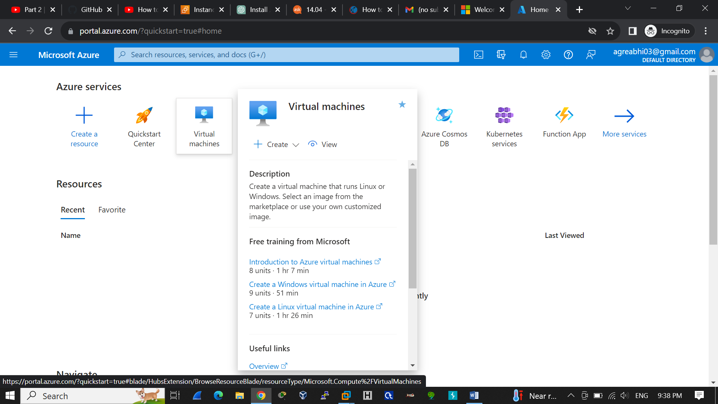
prerequisites
Before starting installation process, make sure have Cloud account , a virtual machine running on debian

Slide 10
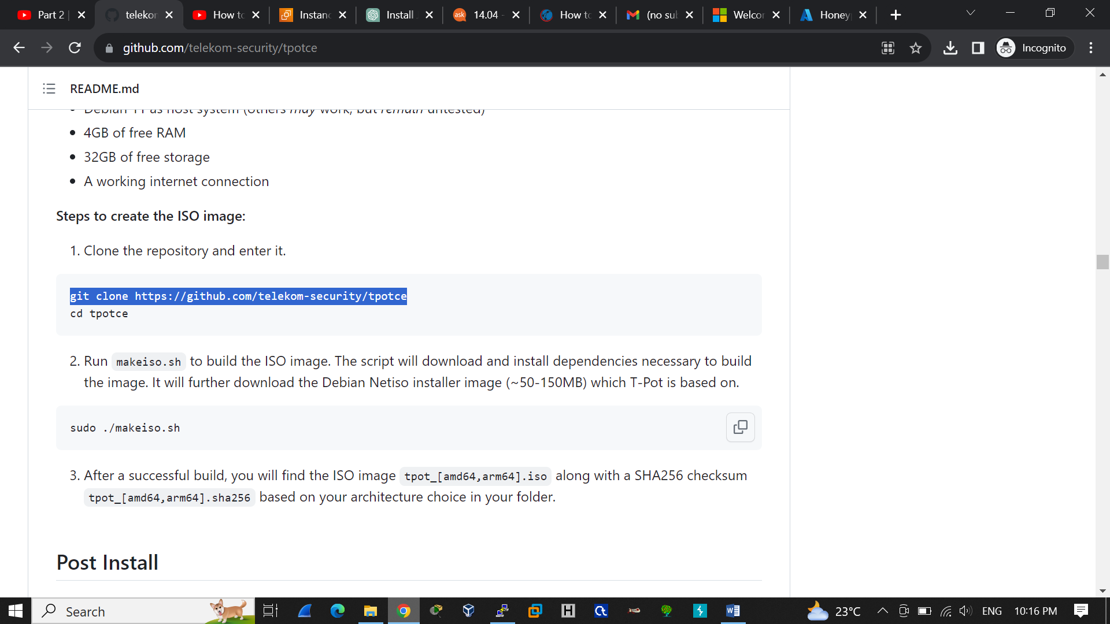


Slide 11

T-Pot Landing Page

Slide 12
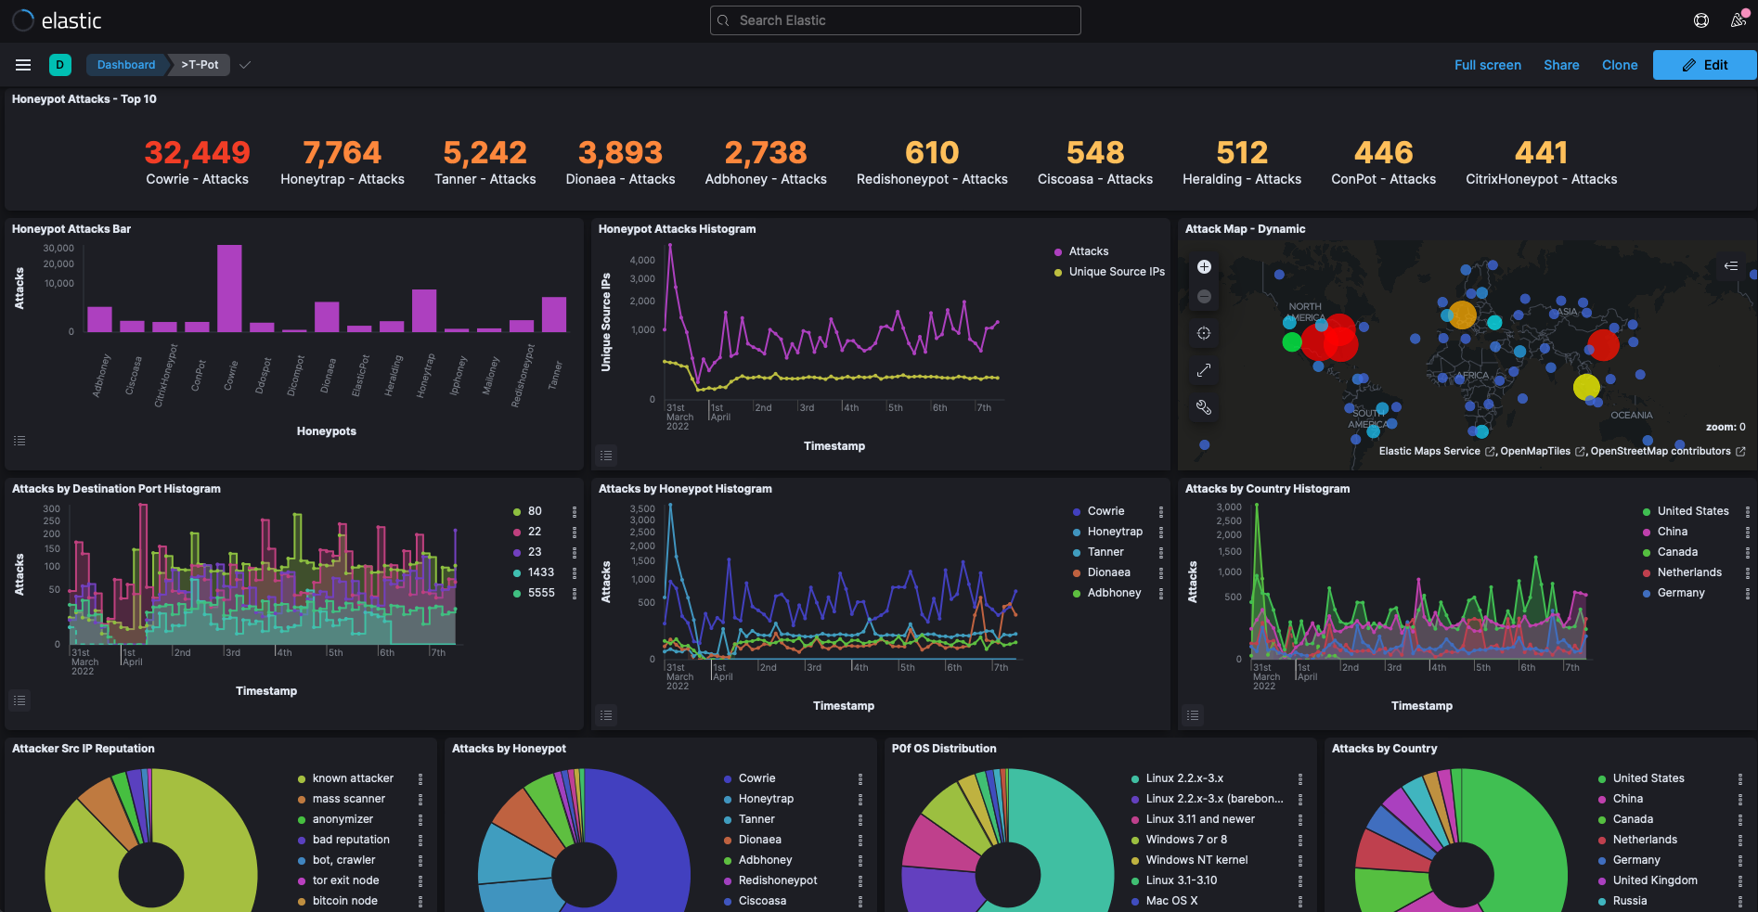
Kibana Dashboard

Slide 13
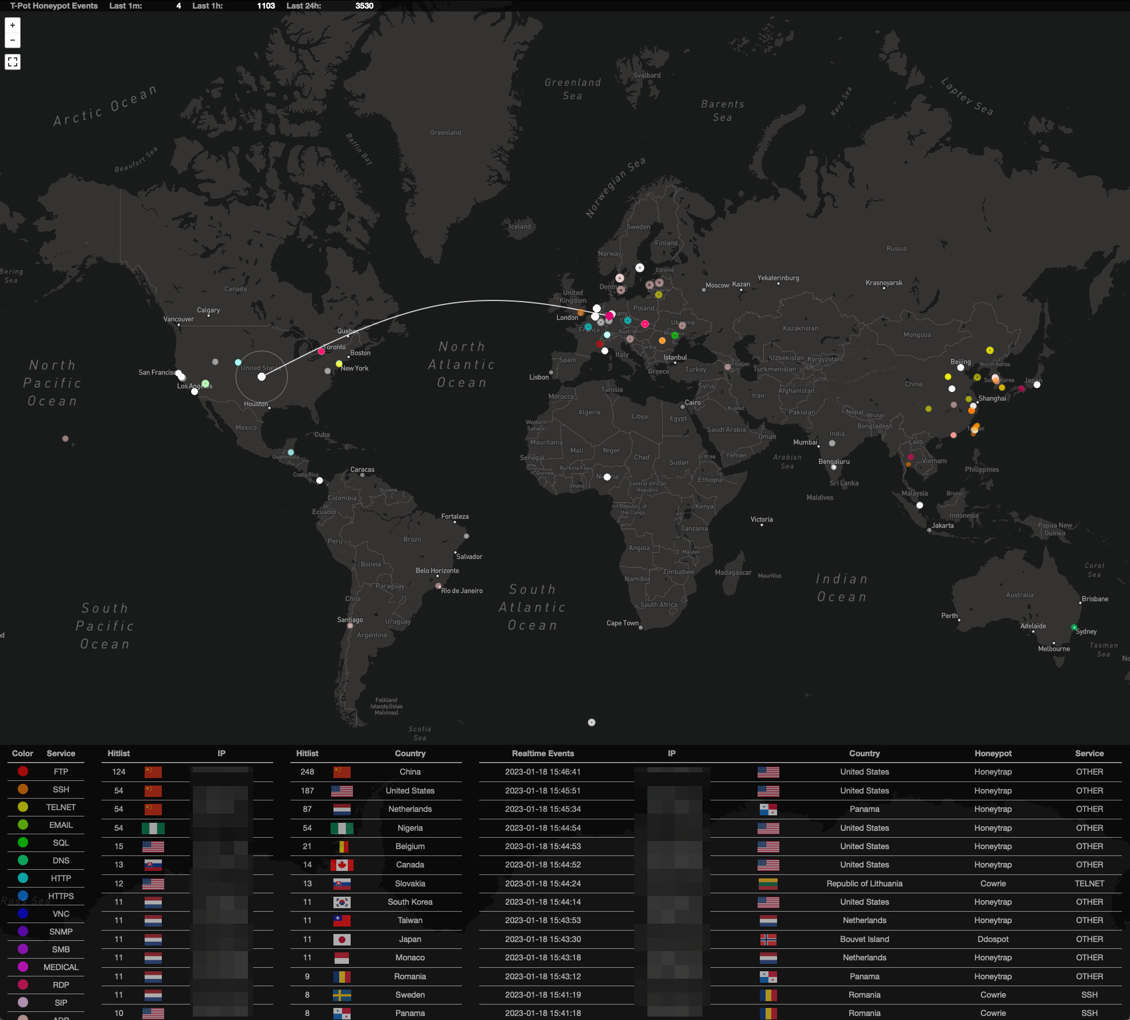
Attack Map

Slide 14
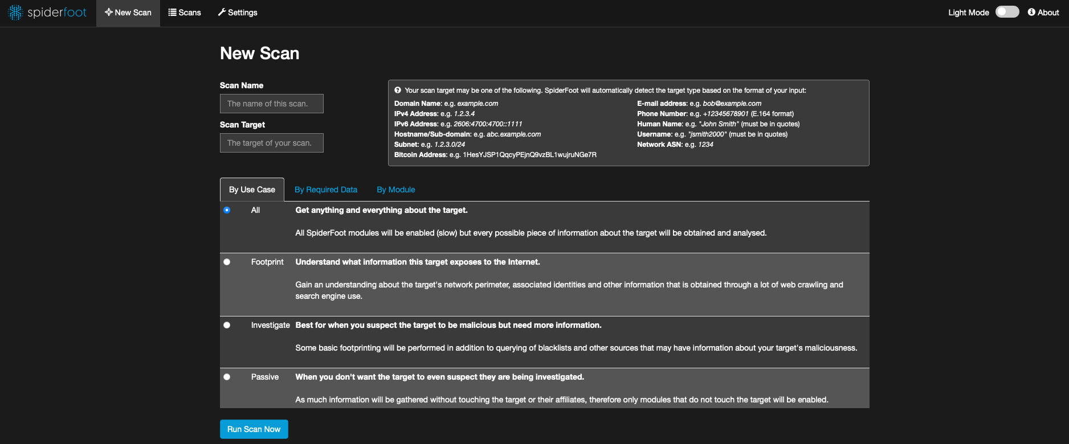
Spiderfoot

Slide 15
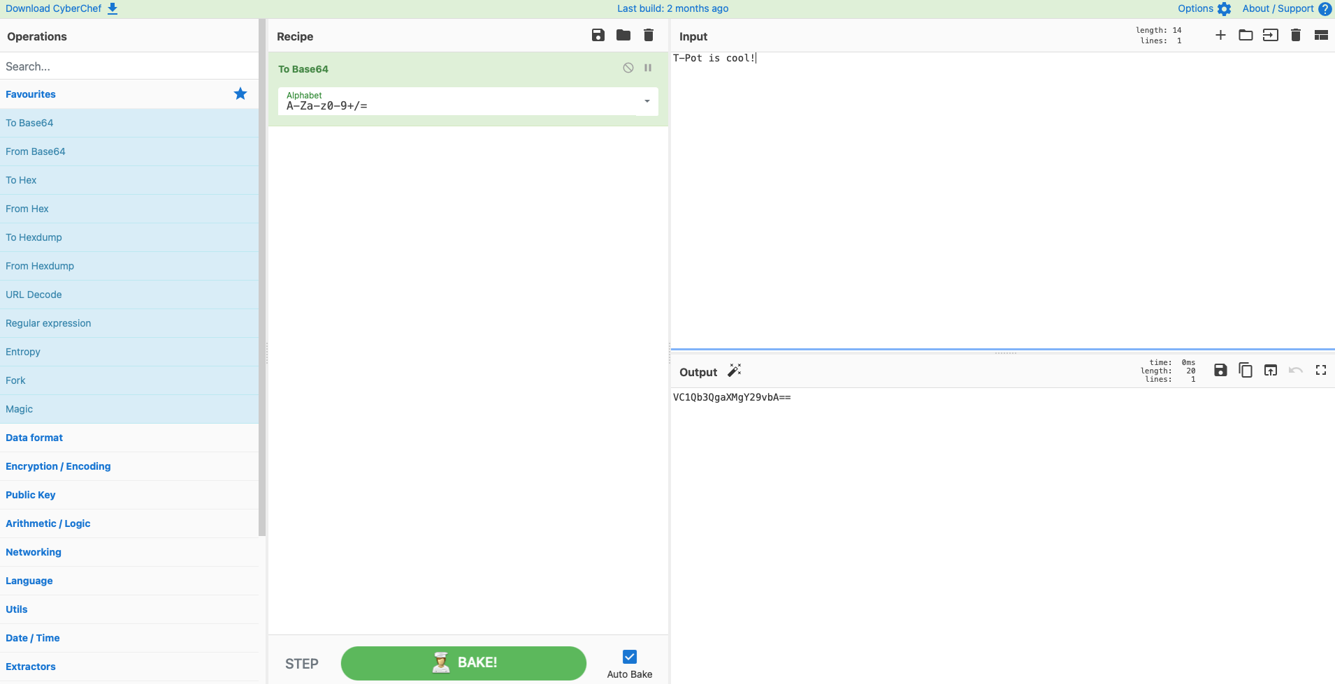
Cyberchef

Slide 16


Slide 17
THANK YOU

